Slide 1

Presentation on
Apna Banaras
Session: 2024-25
Department of Computer Science & Engineering
BBS College Of Engineering & Technology
Pryagraj - 211013

Slide 2
Apana Banaras
Mentor Presented by
Ms. Shreya Agrawal
Keerti Tiwari
Jyoti Yadav
Jaya

Slide 3
Introduction of project
Objective: To promote Banaras (Varanasi) as a top tourist destination through a user-friendly website that provides comprehensive travel information.
Scope: The website will showcase Banaras' rich cultural heritage, temples, ghats, food, festivals, and places to visit.
Target Audience: Domestic and international tourists, travel agencies, and anyone interested in the history and culture of Banaras

Slide 4
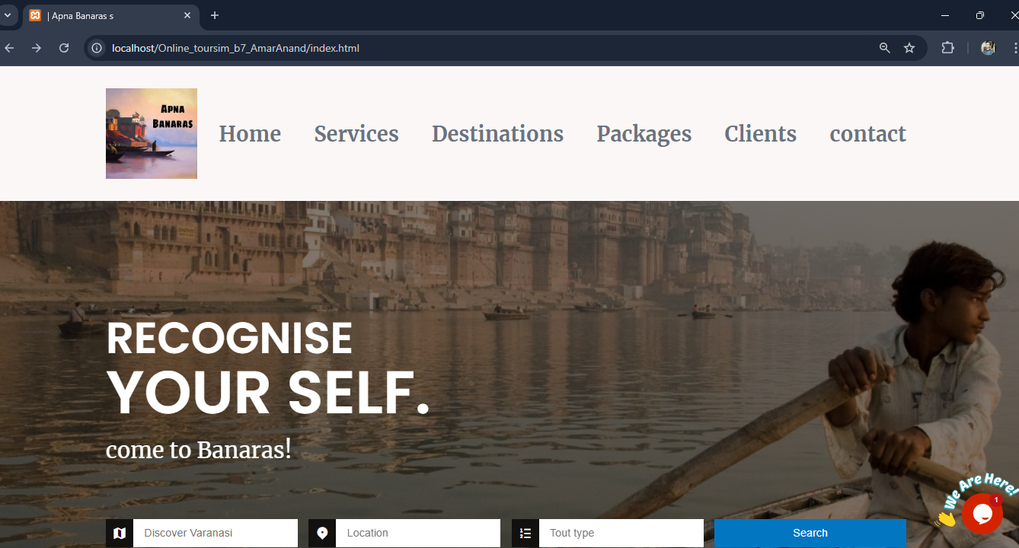

Slide 5
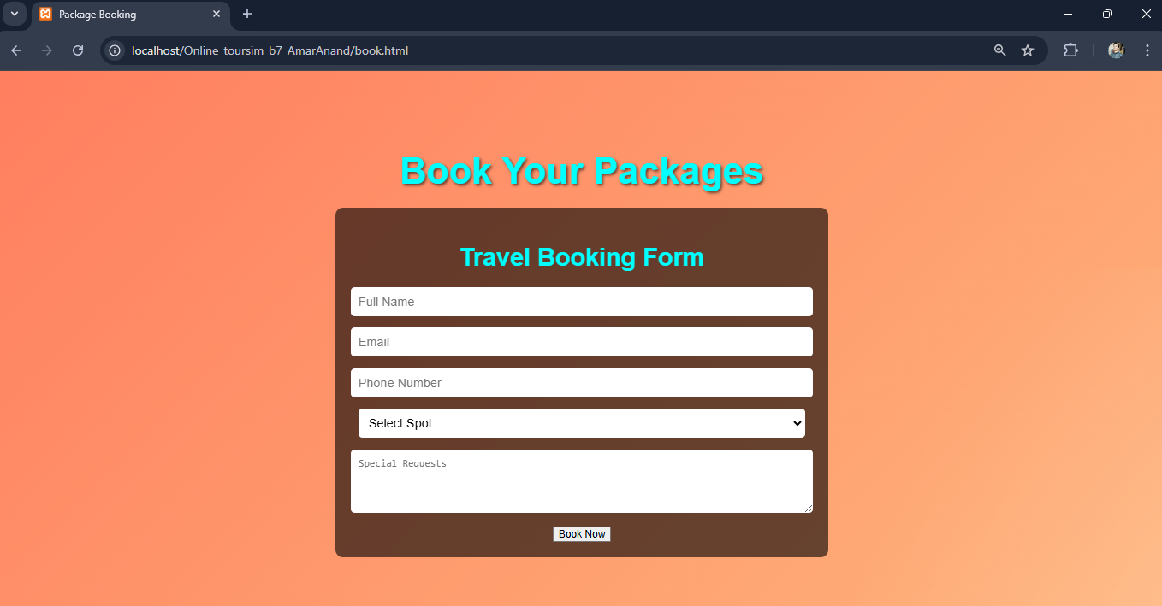

Slide 6
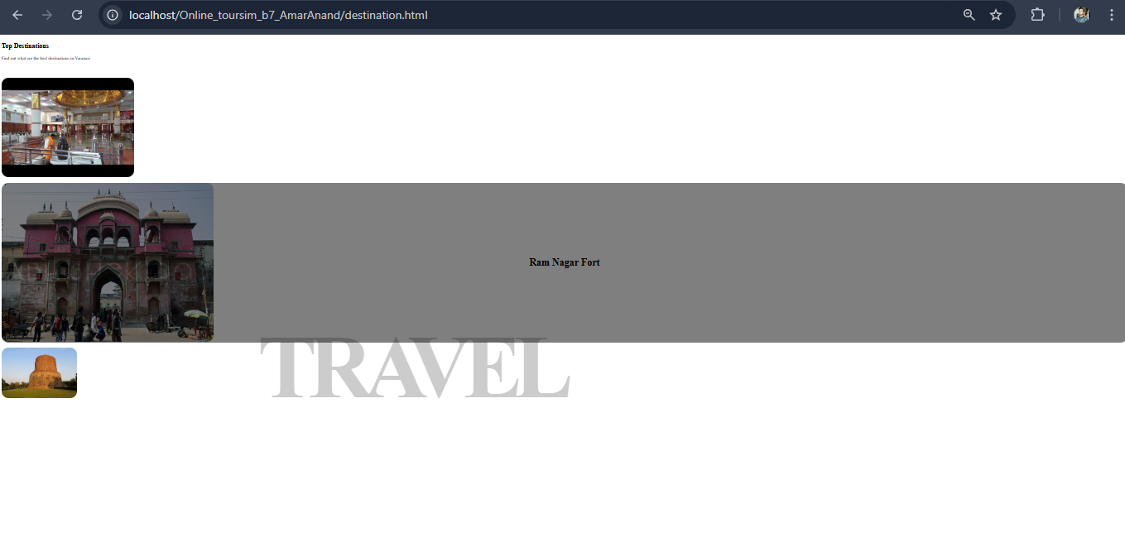

Slide 7
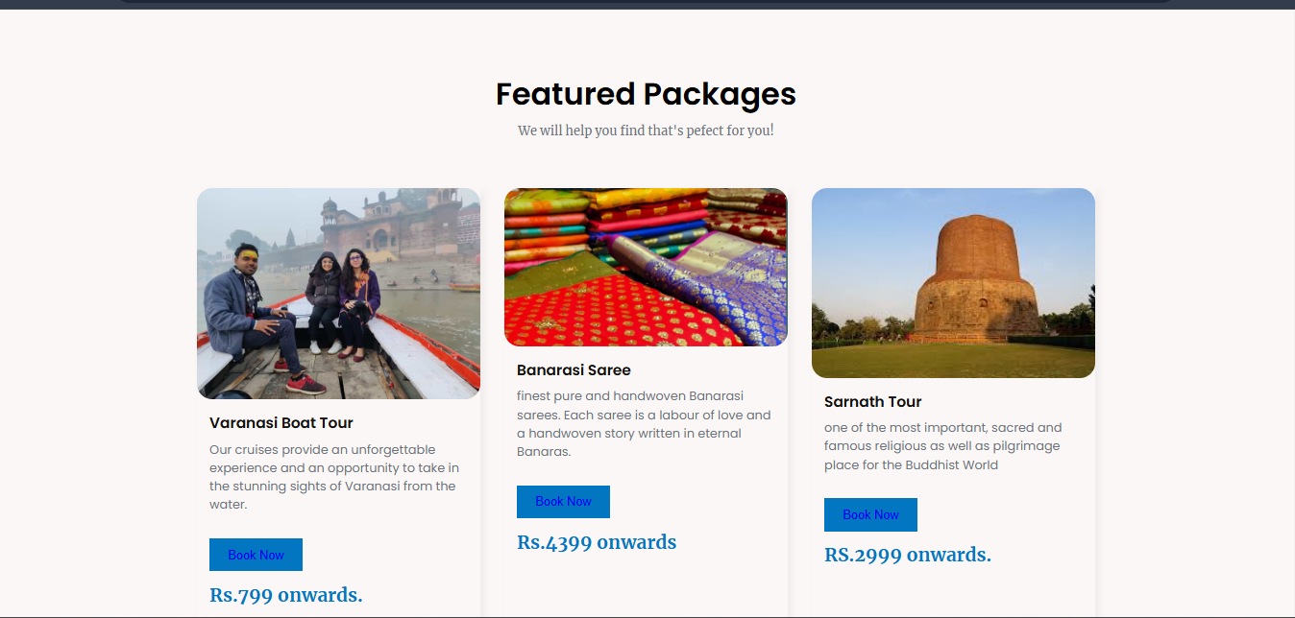

Slide 8
Features of the Project
User-Friendly Interface
Booking
Updation
Multi-platform Accessibility
Scalability
Security
Transparency

Slide 9
Technology Used In This Project
Front-end :
HTML
CSS
Java script
Libraries :
BOOTSTRAP
IDE:
Vs Code

Slide 10
Modules Of Project
Booking System

Slide 11
Future Scope of the Project
We will add other city
Adding Backend

Slide 12

1
ANY QUERY ?

